Slide 1
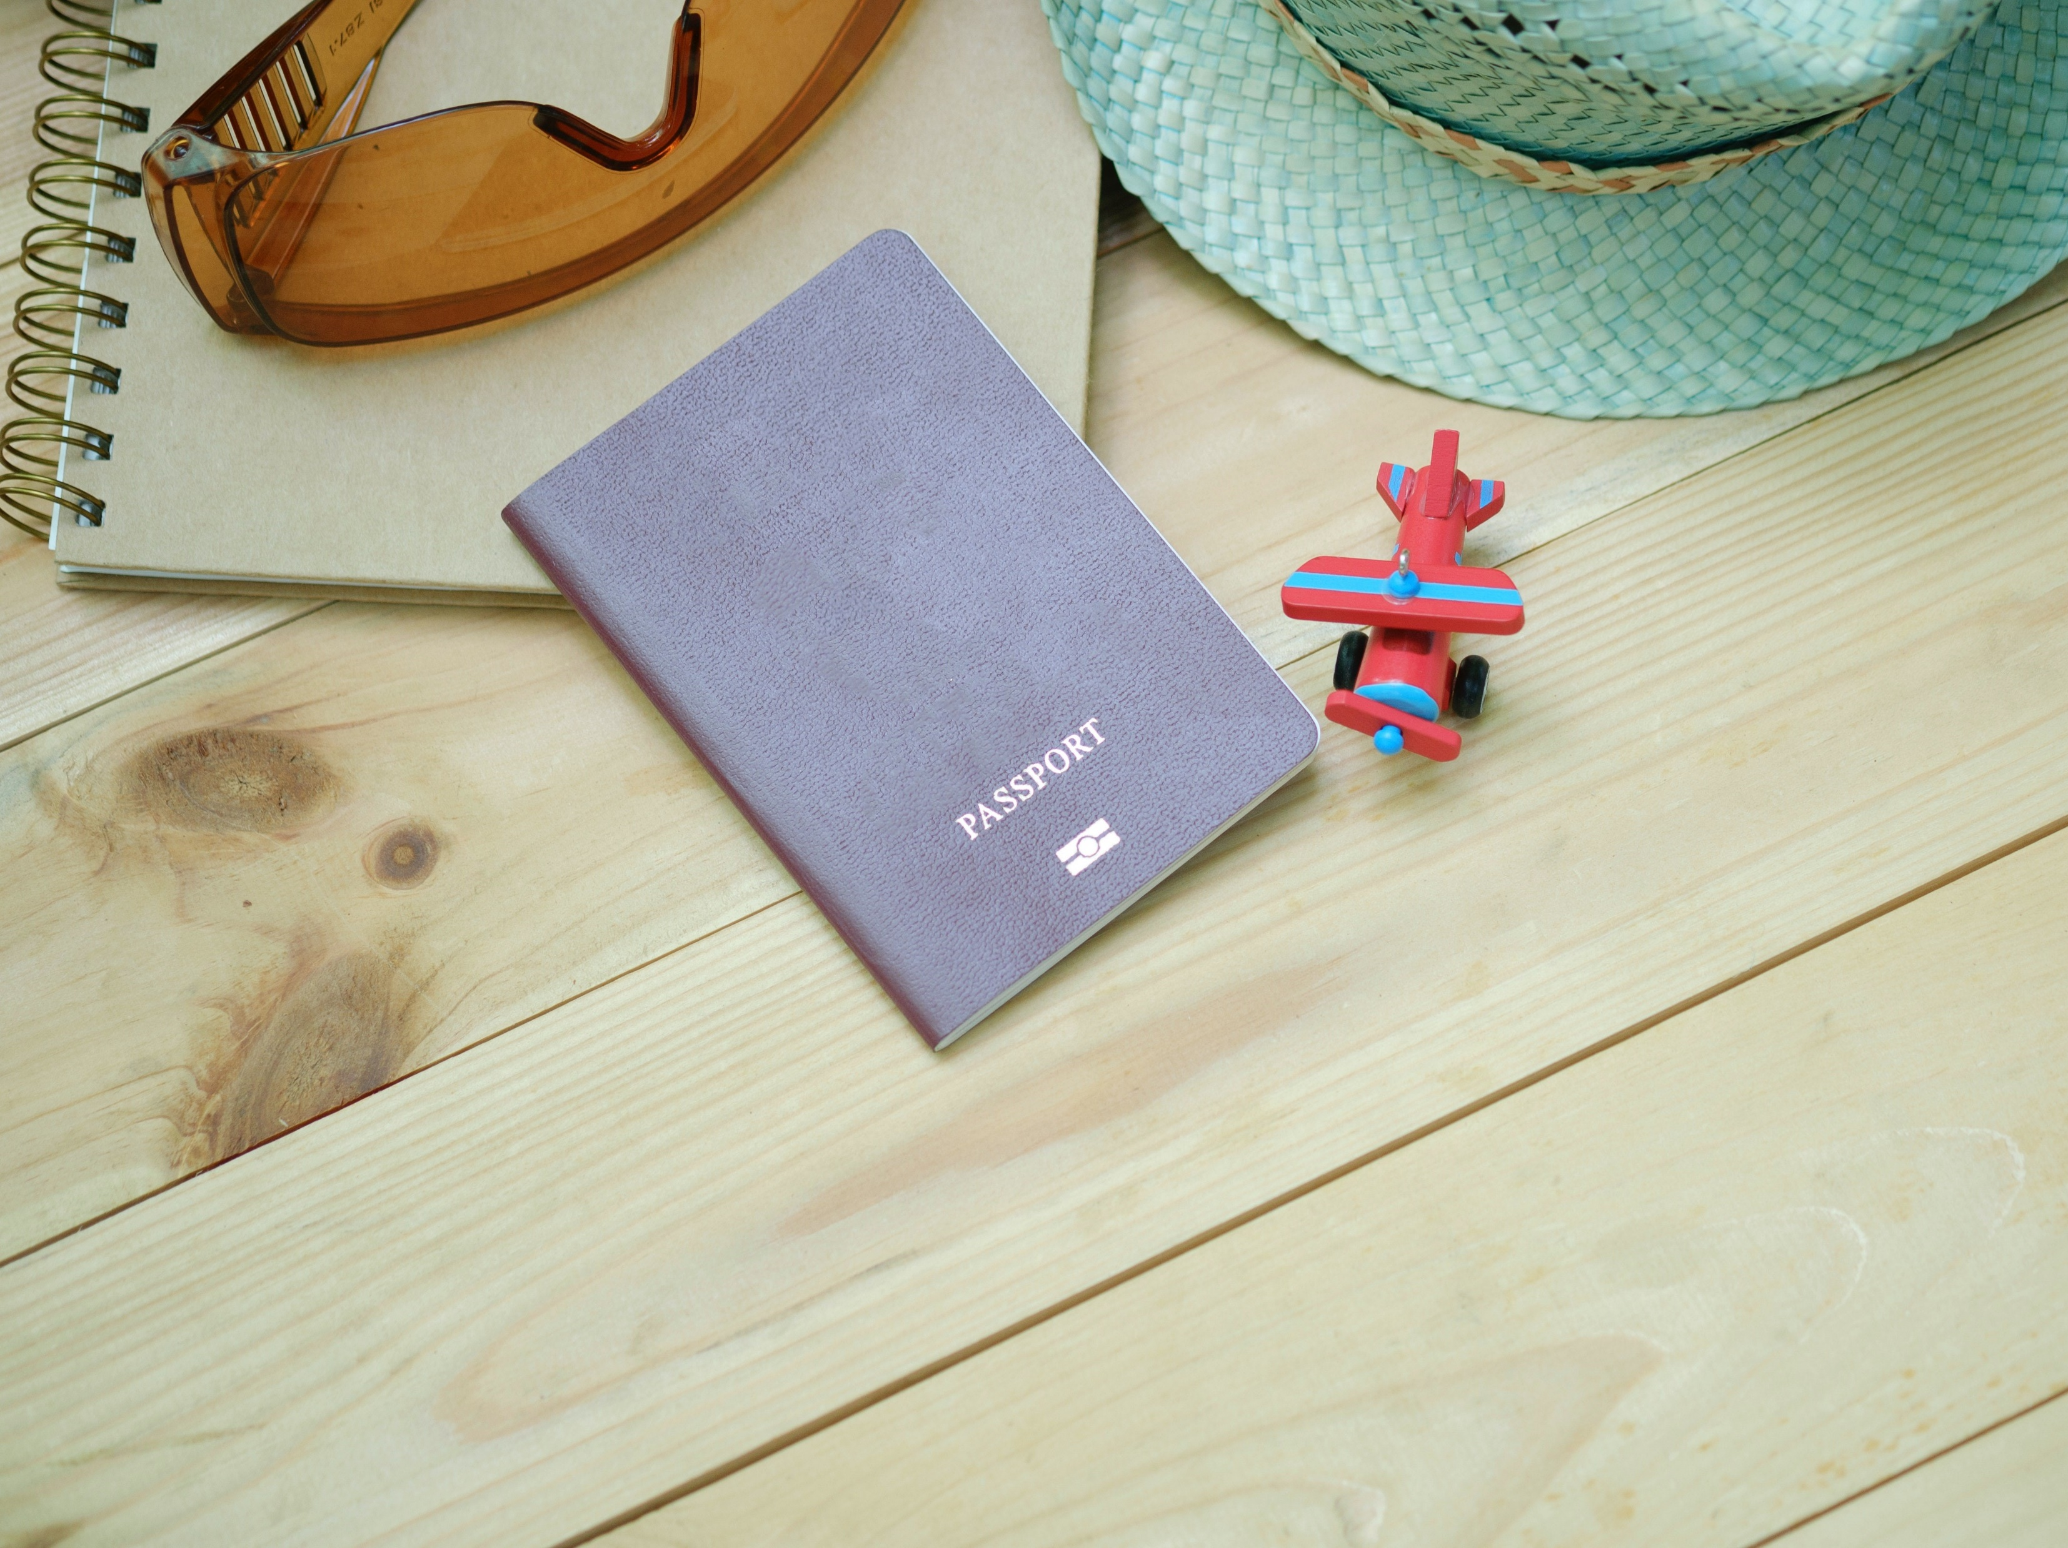
Gloucester’s Summer Passport Sponsorship Pack 2021

Slide 2
Gloucester’s Summer Passport
Aim:
Encourage repeat visits to the City for both residents and tourists, or visits to multiple locations throughout the City for single day visitors.
How:
By creating a loyalty style card, whereby people can visit multiple venues/businesses throughout the City and collect a sticker from each place they visit to complete their ‘sticker collection.’ Once completed they can take their card to the TIC to collect their prize. Suggest 8 stickers needed for completing their passport from the 20 partners involved.

Slide 3
Gloucester’s Summer Passport
Impact:
Provides Digital and Social Campaign content for the summer.
Encourages repeat visitors.
Encourages visitors to spread and spend throughout the City.
Lanyards will be worn, creating walking adverts and conversation starters, word of mouth campaign promotion.
Water bottles will also be visual adverts when in use at school, sports events etc.

Slide 4
Gloucester’s Summer Passport
Duration:
Event to run from mid-July until the beginning of September – School Holidays
Partner Involvement:
Businesses and attractions to become ‘sticker destinations.’ These partners would each have sheets of their sticker to hand out to the children who came in to collect – the view is that this drives traffic to each location, increasing awareness, spend and visitor numbers.
Each Partner involved would sponsor the sticker for their business
NB. Logo and Branding for the event still TBC

Slide 5
Gloucester’s Summer Passport
A recent mini-campaign we ran saw the following:
Organic Reach on Social Media in excess of 6.5k
Paid Boost on Social Media had a reach of 27k
332 Engaged on Social Media with the Campaign
191 Landing Page Views
We predict the impact of the Summer Passport to have a greater impact.
Visit Gloucester currently has 37k followers on Social Media Channels, and on average 20k users per month to our website.

Slide 6
Gloucester’s Summer Passport Platinum Sponsor - £2,750 (1 available)
Logo and branding on Lanyard and ‘Passport’
Acknowledgement on press releases and media opportunities
Logo on Gloucester’s Summer Passport Page on the Visit Gloucester website
Logo on Social Media Advertising
NB. Initial quantities to be produced 1000
Sponsor Confirmed

Slide 7
Gloucester’s Summer Passport Gold Sponsor - £2,250 (1 available)
Logo and branding on an aluminium water bottle, which children will collect as a reward for completing their sticker passport
Acknowledgement on press releases and media opportunities
Logo on Gloucester’s Summer Passport Page on the Visit Gloucester website
Logo on Social Media Advertising
NB. Initial quantities to be produced 1000

Slide 8
Gloucester’s Summer Passport Business Sponsor - £75 (20 available)
Logo or image on 1000 stickers, to be collected by participants towards completing their passport.
Acknowledgement on press releases and media opportunities
Logo on Gloucester’s Summer Passport Page on the Visit Gloucester website
Logo on Social Media Advertising

Slide 9
Gloucester’s Summer Passport Grand Prize Draw Sponsor – £150 (1 available)
Provide the prize for the Grand Prize Draw, entry is open to anyone who has completed their passport
Acknowledgement on press releases and media opportunities
Logo on Gloucester’s Summer Passport Page on the Visit Gloucester website
Logo on Social Media Advertising

Slide 10
Gloucester’s Summer Passport
For more information or to secure your place as a sponsor, please contact:
Zoe.Larder@gloucester.gov.uk
Deadline for sponsorship confirmation is 9 July 2021

